Slide 1
Collective worship
The Lord’s prayer

Slide 2
Let’s listen together

Slide 3
In the name of the Father

Slide 4
And of the Son

Slide 5
And of the Holy Spirit Amen

Slide 6
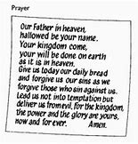

Slide 7
Once again, we sing about the rainbow and think about all the pictures of rainbows we see when we go out for our walk

Slide 8
You can watch the video about the Lord’s Prayer

Slide 9
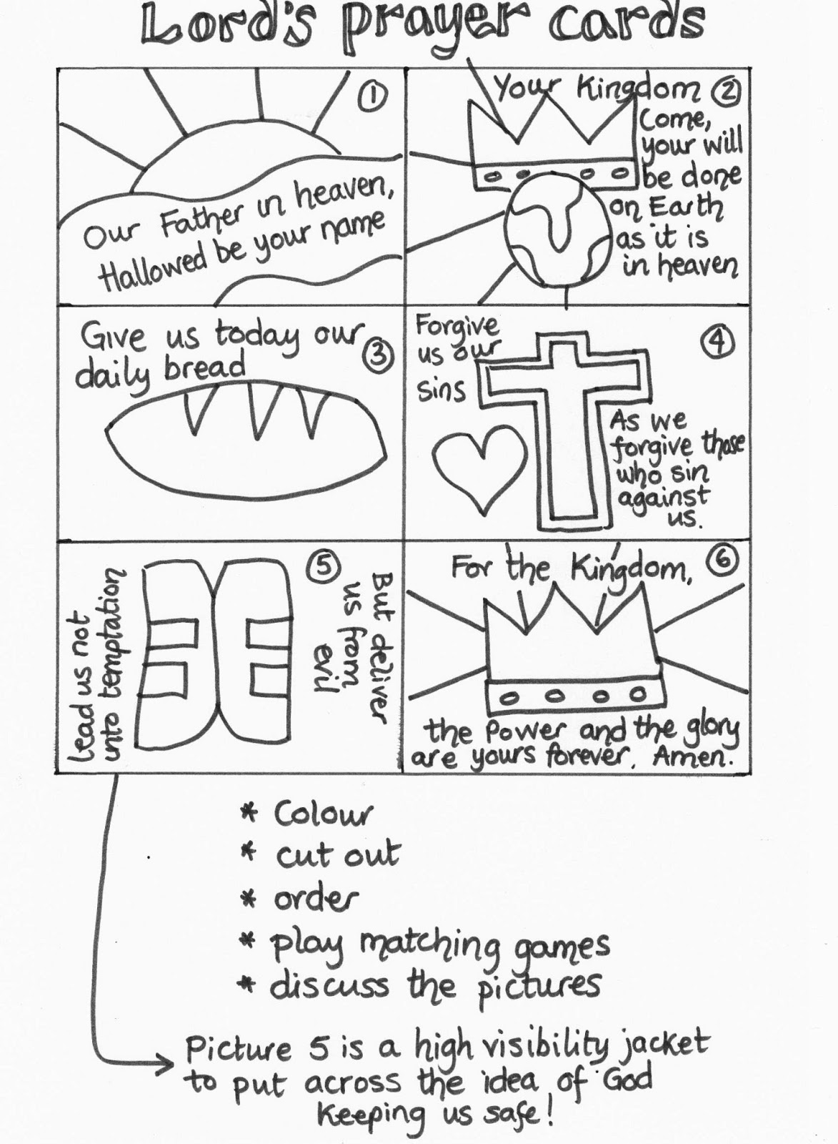
Can you make your own Lords prayer, prayer card?

Slide 10
Jesus taught us the Lord’s prayer
To praise God
To say sorry
To think of others
To give thanks

Slide 11
Let’s Pray
Father God
Help us to say our prayers, to love you and love one another
In Jesus name
Amen

Slide 12
Prayer of Blessing

